Slide 1
EML Data Package Checks for PASTA
2012 August 6 & 7
IMC EML Congruence Checker and Metrics Working Group

Slide 2
2010 Activities
IMC introduced to the EML Congruency Checker project
EML Best Practices Update (workshop)
Breakouts at Annual Meeting (KBS)
collect information from IMC
lists of desired checks
evaluation behavior

Slide 3
2011 Activities
5 checks
entity-level data URLs are live
database table can be created from metadata
data can be loaded into database
number of records stated matches inserts (info)
display first row of data (info)
tested >6000 LTER data packages against V 0.1 code (August and December)
aggregated results for developers and sites

Slide 4
2011 Activities, cont.
IMC annual meeting (Santa Barbara)
View aggregated stats from August draft
Policies outlined
IMC will produce reports when PASTA in production
More checks identified by Tiger Team
Fine-tune report XML
Workshop for 2012 proposed

Slide 5
2012, March Workshop
determine specifics of quality checks that are required to meet the criteria of the LTER community for high quality data packages
consider the behavior of the Data Manager Library (core code for the Quality Engine)
consider Best Practice recommendations and EML construction currently in use
prioritize checks for the greatest return on investment
Notes:
Main activities for 2012:
1. Workshop to finalize checks for PASTA
workshop participants: IMs (Jason, Gastil, Sven, Margaret) with input from developers (Duane and Ben),
2. PASTA-prototype ready for datsets to be uploaded in May 2012

Slide 6
Workshop Products
Checks - organized by types, status response, with priorities and criteria justified
Draft of a document describing the checks and Quality Engine behavior for comment by stakeholders and NISAC

Slide 7
Progress - May 2012
72 checks have been logged
51 are fully described
20 implemented now
31 in later releases
remaining 21
deprecated
postponed
Notes:
checks are OBJECTIVE and STRUCTURAL. They cannot assess appropriateness, for example, whether these are the correct keywords, or if an abstract's content is appropriate..
They can find structural problems, and the absence of content, but some things still have to be evaluated by humans.

Slide 8
Categorization
Scope
knb, lter, ...
Priority
high, medium, low
Type
metadata, data, congruency
Use
discovery, workflow, PASTA, DAS, good practice
Response status
info, valid, warn, error
Implementation
yes, no
Notes:
categories were necessary for the checks to work as we need.
implementation schedule: It was most important to determine the checks that would produce an 'error', and stop insertion into PASTA. These will have the greatest affect on sites. We also used 'priority', and tried to get the highest priority first.

Slide 9
Response status
Will be either:
info for information only, does not affect acceptance by PASTA
Or one which controls PASTA behavior:
valid all check-criteria were met
warn some problem may be present, but data package is acceptable to PASTA
error data package cannot be accepted
Notes:
Important to know that only ERRORs stop insertion to PASTA.
WARN tells you that something might be wrong
VALID - all criteria of the check were met.

Slide 10
Error
EML is version 2.1.0 or beyond
Document is schema-valid EML
Document is EML parser-valid
All entity-level data URLs are live
The packageId pattern matches "scope.identifier.revision"
There are no duplicate entity names
An entity-level URL which is not set to “information” returns data
Data table does not have more fields than metadata attributes
Data table does not have fewer fields than metadata attributes
Database table can be created from EML metadata
Field delimiter in metadata is a single character
Document is schema-valid after dereferencing
enumeratedDomain codes are unique
Notes:
The goal was to focus on dataset features that were essential to PASTA. So we started with issues that were raised by the 5 original checks (in the 2011 draft run). Some checks were split. (example, there is one to check that a URL is live, then a separate check to be sure it returns data and not something like an HTML page. either one would be an errorl)
Error checks are probably the most important. If the check criteria are not met, PASTA will stop. A single error will cause the dataset to be rejected.

Slide 11
Warn
Data can be loaded into the database
Length of entityName is not excessive (less than 100 char)
A methods element is present
Record delimiter is present in metadata
Data examined and possible record delimiters returned
Number of records in metadata matches number of rows loaded
at least one controlled vocabulary term is in keywords
dataset title length is at 5 least words
dataset abstract element is a minimum of 20 words
one of dataTable, view, spatialRaster or spatialVector is present
...
Many more not yet implemented
See report
Notes:
warn checks are the biggest group. Some of these were requested for reasons of good practice. Warn-checks would tell you that something might need attention, but it is not going to stop entry into PASTA. For example, the number-of-rows check compares the rows of data inserted to the database to the number of rows in metadata. If these are not equal, PASTA doesn;t really care -- it can still use the data. PASTA can't tell which value is correct, but the submitter ought to know that they don't match, and can use their judgement to figure out how to handle it..
This group also contains checks that could be errors if necessary. For example, the first one -- "data can be loaded into the database" -- this one was an 'error' in the 2011 run. But the database backend is not required for PASTA, or for workflows. Also there are some issues handling date formats that still need to be resolved. So here, it is a warn.

Slide 12
Info
Display downloaded data
Display first insert row
temporalCoverage element is present
geographicCoverage is present
taxonomicCoverage is present
...
Many more not yet implemented
See report
Notes:
Info checks are just that - they are for information only. So this is where we put the Checks to simply display some data for a visual check.
Also in this group are the coverage checks, because all three are probably not appropriate for all datasets, so it wouldn't be correct to make them as high as a 'warn' there are some subjective aspects of data sets that we just cannot really measure.

Slide 13
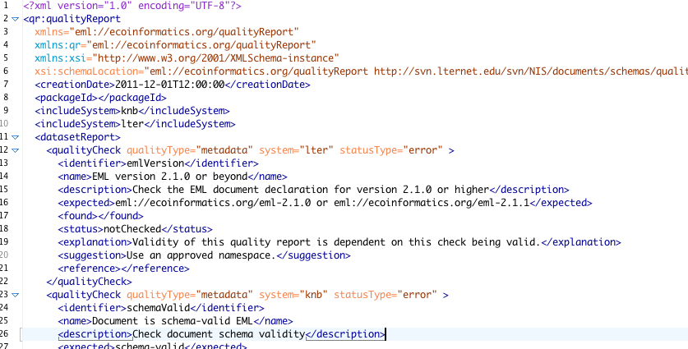
XML Report Template
Notes:
The report info is collected in an XML file. The XML file is also the 'template', where the operator (Duane) sets the configuration for each check. If you look a a raw XML file, you can see the values for scope and response set for each check.

Slide 14
PASTA Behavior
mode = evaluate
checker continues after a failure so that a submitter sees as many problems as possible all at once
mode = harvest
checker stops on the first error
EVALUATE FIRST!
Notes:
Typically, and EML parser will stop as soon as it hits an error. One of the requests for the checker was that we see as many errors as possible all at once, rather than have to peel them away one at a time. So when run in evaluation mode, the checker goes as long as it can, to tell you as much as possible.
In harvest mode, all the same checks are run, but there is no part in continuing after the first error.

Slide 15
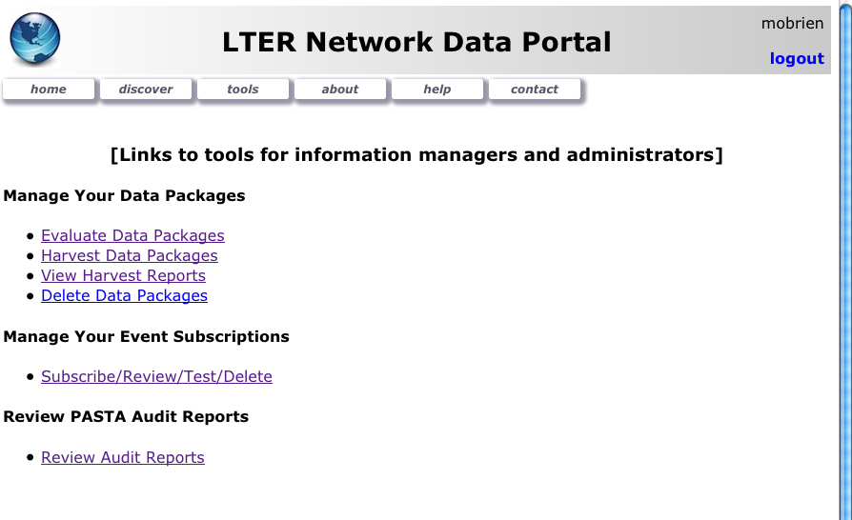
portal.lternet.edu

Slide 16
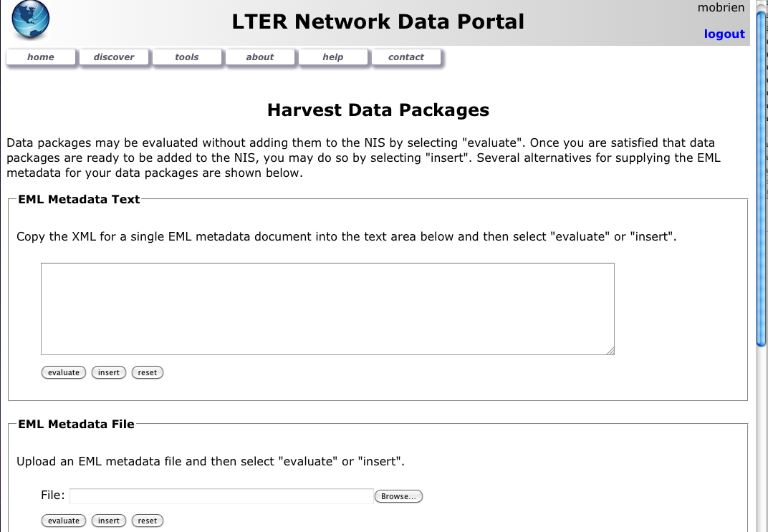
portal.lternet.edu
You can:
paste in an XML doc
browse to a local file
enter individual URLs
enter URL for a harvest list

Slide 17
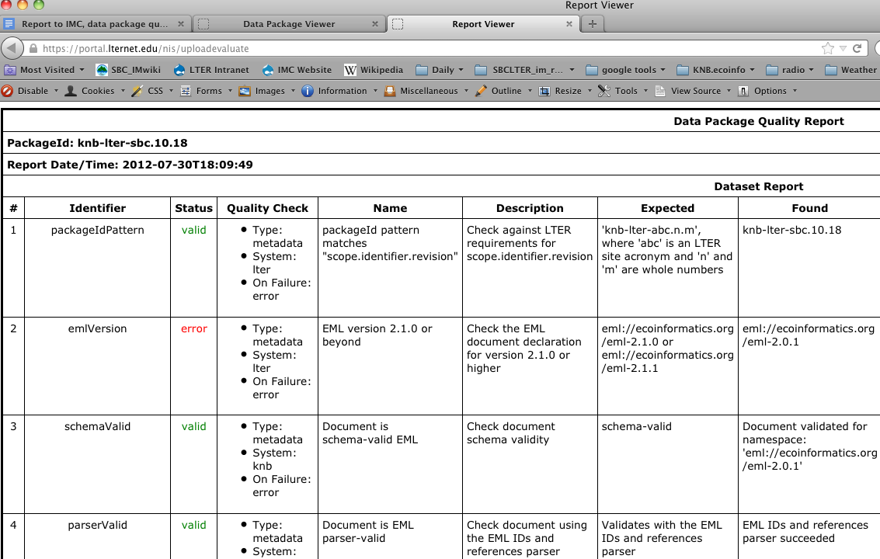
XML report, transformed
Notes:
This is the initial view of an XML- report transform. Obviously, reports can get very long, and only 40% of checks are here. There might be some ways to condense this.

Slide 18
Checks are still evolving
31 planned checks not yet implemented
Checks were deliberately postponed
constraints
congruence of coverage elements and data
Additional checks may be requested
Response status may be altered
warn might be elevated to error
Notes:
There are still 31 checks planned but not yet implmented. Most of these are warns or infos.
Several checks were postponed or deprecated. Postponed checks often have very complicated logic or may need to be thought through further or split. They may be too subjective to ever be encoded.
Deprecated checks were left in the list mainly so they would not be forgotten and be added again! Often these were deprecated because another check had made them unnecessary, or they simply were not valuable.

Slide 19
2012 Drafts, compared
PASTA check implemented | Metrics WG 5+5 (May 2012) | Scott's "5 features" (Apr 2012) | How the EML feature is used
X | title | title | HTML display, search
X | abstract | abstract | HTML display, search
X | keywords | keywords | search
X | entity-level data URL | entity-level data URL | HTML, download, PASTA
X, X (many) | data table is described | data table is described | user evaluation, PASTA
X | EML 2.1 or later |  | PASTA
X | methods |  | user evaluation
X | temporalCoverage |  | search, user evaluation
X | geographicCoverage |  | search, user evaluation
X | taxonomicCoverage |  | search, user evaluation
Notes:
In March, April and May, the ECC group held the workshop, and also began the EML mentoring. All through then, we were querying data packages with Metacat queries.
So this table shows the lists of EML elements that were queried, and how they map to checks that are planned for the PASTA checker.
The two middle columns are the EML features that were highlighted in April and May, mainly in emails.
Third col: what Scott requested from LPIs in late April. Every IM saw this, and the EB got the summary.
Second column: checks that the metrics working group had queried as part of the workshop, and then build an aggregate report from for the Site IMs. We did this when the supplement was announced. No one else got this except PIs and SIMs
Left: The left column shows the current state of implementation of the checks for each of these features.
If

Slide 20
Process still to be defined
One option:
IMC sub-committee reviews checks periodically
Proposed changes are announced
Community reviews changes
Waiting period, e.g., 6 mo - while you check your packages against the staged implementation
Implementation

Slide 21
Discussion prompts
Do you see yourself
checking one data package at at time?
a whole lot at once?
(how do you build your list of URLs?)
Should there be a data package summary?
what does it hold?
metadata level checks?
Can you use this to build your site's inventory?
for an annual report?
for a proposal?

Slide 22
Discussion prompts, cont.
PASTA has a few requirements
related to data table structure
error response assures these will be met
Metrics do not imply requirements
'metrics' is counting features, calculating stats
can be used to plan improvements objectively
To date, all tallies have been internal
to sites, individual
to EB, aggregates
Notes:
example metric: X proportion of data packages has a data URL
example expectation: that some particular proportion of data packages have a url (for example over 75%)

Slide 23
Discussion prompts, cont.
Uses of certain EML metadata features
"5 essential features" (Scott, April, 2012)
those needed for search and/or fitness for use, (coverage)
Eventual reporting
to whom? what? when?
IMC annual meeting

Slide 24
Goals for IMC
Approve V 1.0 checks and system
Agree that aggregate reports should be produced for the EB
Request the 6 more checks be implemented in PASTA
Request entire LTER inventory be checked and aggregates calculated when PASTA in production
Notes:
We need to be prepared for these issues to be decided on during the annual IMC meeting
We would like the IMC to approve the 20 v1.0 checks as they are outlined here, the system for creating an XML doc, and the plan for updates.
the committee needs to agree that the IMC should be ones to develop and shares reports on progress, as opposed to some external body
3) We would like to add 6 more checks to the quality engine (gray x's in slide 19)
4) We won't know the proportion of our data that can be ingested by PASTA without running these checks.

Slide 25
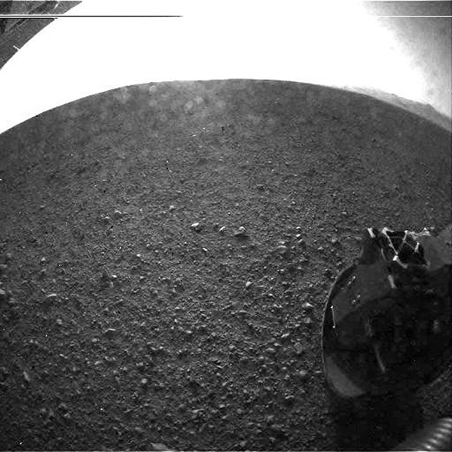
and
GO, CUROSITY!

